Slide 1
Attention is All You Need
Prof. Sarita Azad
IIT Mandi
5th June 2026

Slide 2
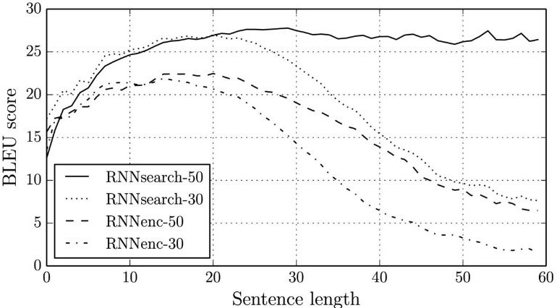
Motivation
Transformers were developed to solve the problem machine translation and sequence transduction, or neural machine translation … but they do so much more!
Great performance in computer vision like ViT (Dosovitskiy, 2020)
Image Classification (CoCa Transformer)
Semantic Segmentation (ex: FD-SwinV2-G Transformer)
Object Detection (ex: FD-SwinV2-G Transformer)
Neural Machine Translation (Bahdanau, 2014)

Slide 3
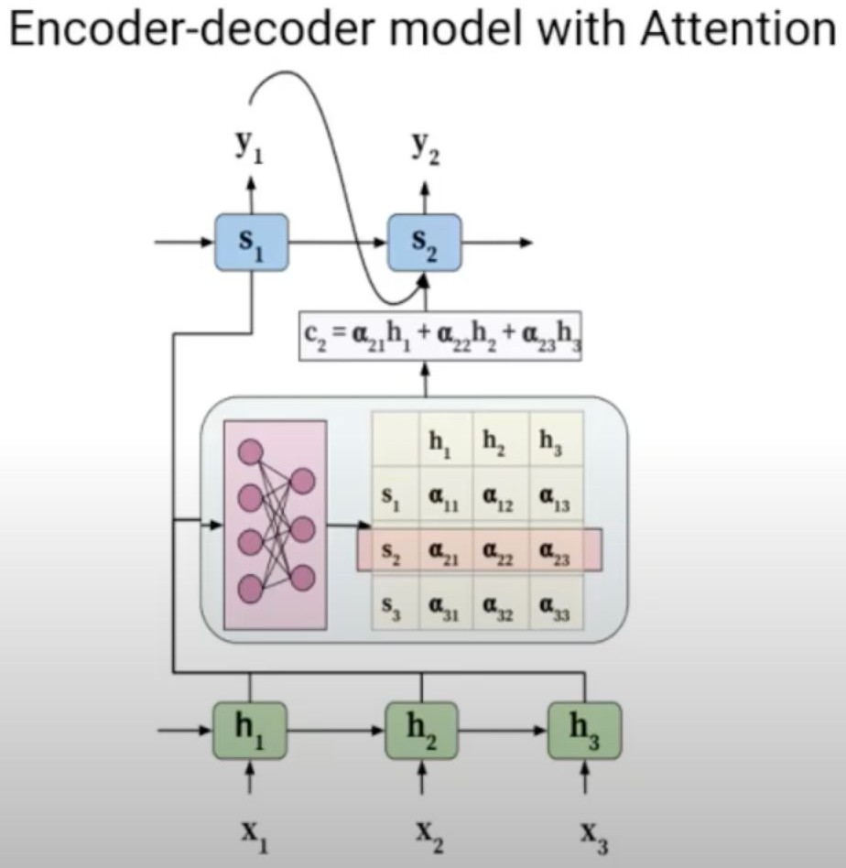
Previous Work
Pre-2014 - RNN, LSTM, GRU
RNNs struggled with long sequence data
Could not handle long sequence lengths (forgetful)
Example on next slide
Neural Machine Translation by Jointly Learning to Align and Translate (Bahdanau, 2014)
Landmark Paper
Proposed New Architecture:
bidirectional RNN as an encoder and an RNN decoder, with an attention mechanism in between
Proposed initial idea of attention
Model gave attention to particular hidden states when decoding each word
Learned which words to give attention to during translation for each word of decoder
Still required on RNN

Slide 4
Context
What issue are they solving?
Previous Work: RNN, LSTM, GRU
Slow to train (inefficient / not parallelizable)
factorization tricks help efficiency but still slow
Suffer from exploding or vanishing gradients
Cannot handle very long-term dependencies
In Seq-Seq models, decoder only accesses last hidden state. Early information in sentence can be lost.
To read the Attention is All You Need Paper. The paper proposes a new simple neural network architecture called the Transformer which relies upon attention. It outperforms RNNs and doesn’t rely on recurrence or convolution.
How would a RNN, LSTM, or GRU fill in the word mask?
Encode name inside cell state
Transfer cell state from one word to another
Decode name from previous cell state
Definitely not ideal! There has to be a better way …

Slide 5
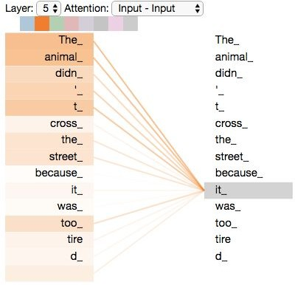
Self-Attention
Each element attends to every other element
It is an attention mechanism relating different positions of a single sequence in order to compute a representation of the same sequence
Each element becomes query, key, and value from the input embeddings by multiplying by a weight matrix
https://jalammar.github.io/illustrated-transformer/

Slide 6
Idea Behind Attention
From Paper - “A mapping a query and a set of key-value pairs to an output, where the query, keys, values, and output are all vectors. The output is computed as a weighted sum of the values, where the weight assigned to each value is computed by a compatibility function of the query with the corresponding key” - (Vaswani, 2017)
Goal: Learn (differentiable) how to pick relevant information from input data
Create three vectors from each of the encoder’s input values (query, key, value)
Calculate a score for how much to focus on each part of the input when we encode words at specific positions
How?
Actual math on the next slide, but the idea is to select a value (referenced by a key) relevant to a query (what trying to pull from input)
key | value
name | Quinn
position | quarterback
Handedness | right
Keys and values are actually word embeddings, not words

Slide 7




Scaled Dot Product Attention
Key algorithm in transformers
Attention weights: how likely each query
matches key (used for weighted sum of values)
Dividing by d_{k} makes algorithm easier to train
input consists of queries and keys of dimension dk, and values of dimension d
Queries packed into matrix Q
The keys and values are also packed together into matrices K and V .
prevents binary prediction of one 1 and a whole bunch of zeros
helps the gradients flow
queries keys
values
outputs
then can take loss, backpropagate, update the weights and values
NOT stepping through a sequence like with a RNN
.
=
softmax
Inputs
Wq
sqrt(num dimensions in key)
In
Robotics
Today
…
Wk
Wv

Slide 8
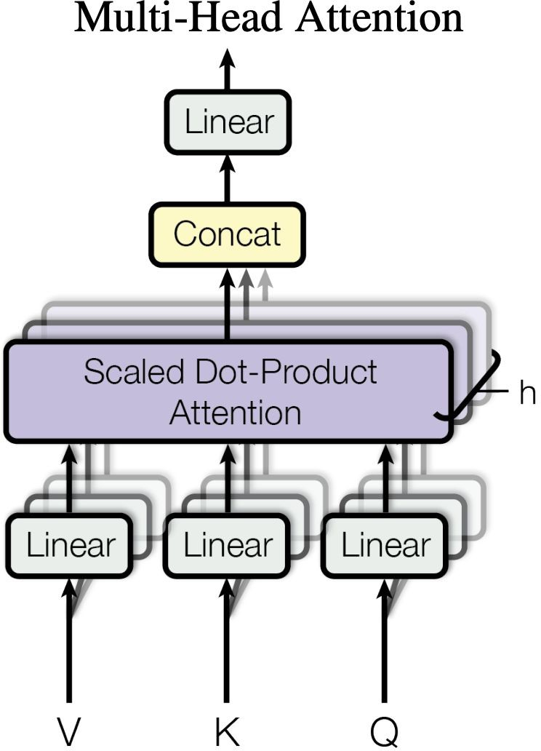
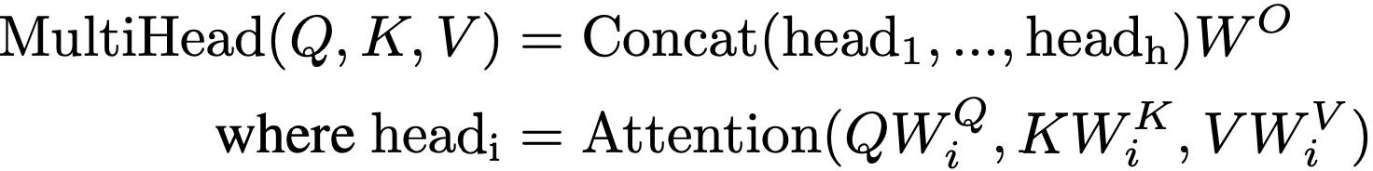

Multi-Head Attention
Idea: a.
Stack linear layers (weight matrices without biases) that are independent each for keys, queries, values.
b. Concatenate output of attention heads to form (plus non-linearity) output layer
Why?
Allows for model to focus on different positions
Gives attention layer multiple “representation subspaces”
No longer need to oversaturate one attention mechanism
Learnable parameter matrices

Slide 9
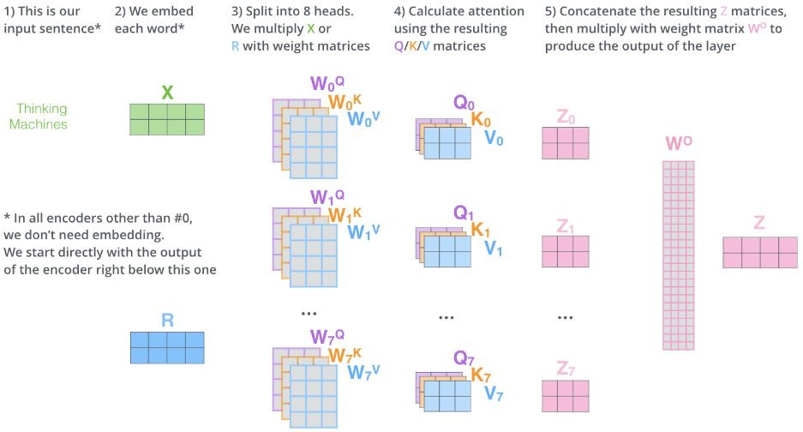
Multi-Head Attention Continued
Key points:
We calculate 8 different attention heads, but we need to combine them
Attention heads are independent of each other
https://jalammar.github.io/illustrated-transformer/

Slide 10
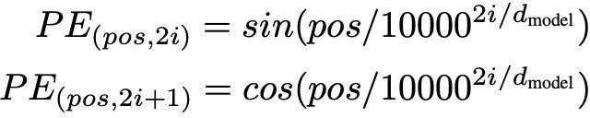
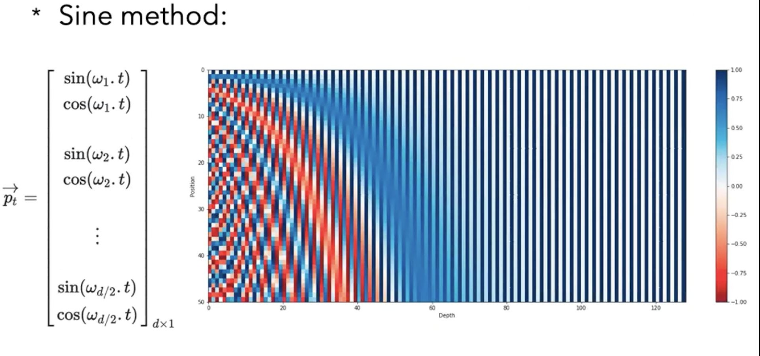
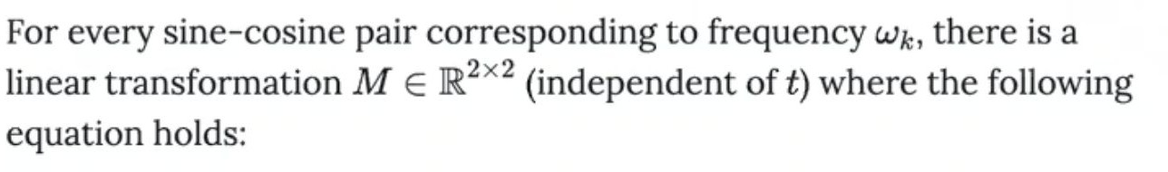
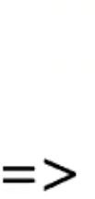
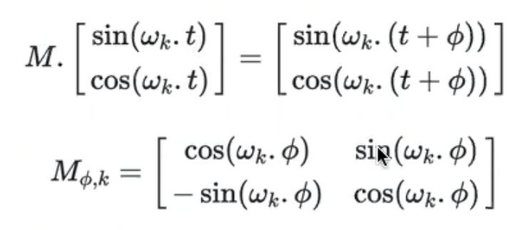
Positional Encoding
Encoding used in paper
Need for information about the position and order of tokens in a sequence
Positional Embedding: Vector that represents position of each token
Element wise addition the position embedding to the word embedding vector
Positional embedding be fixed or learned
“We chose this function because we hypothesized it would allow the model to easily learn to attend by relative positions, since for any fixed offset k, PEpos+k can be represented as a linear function of
PEpos.”
Note: positional embeddings are now learned

Slide 11
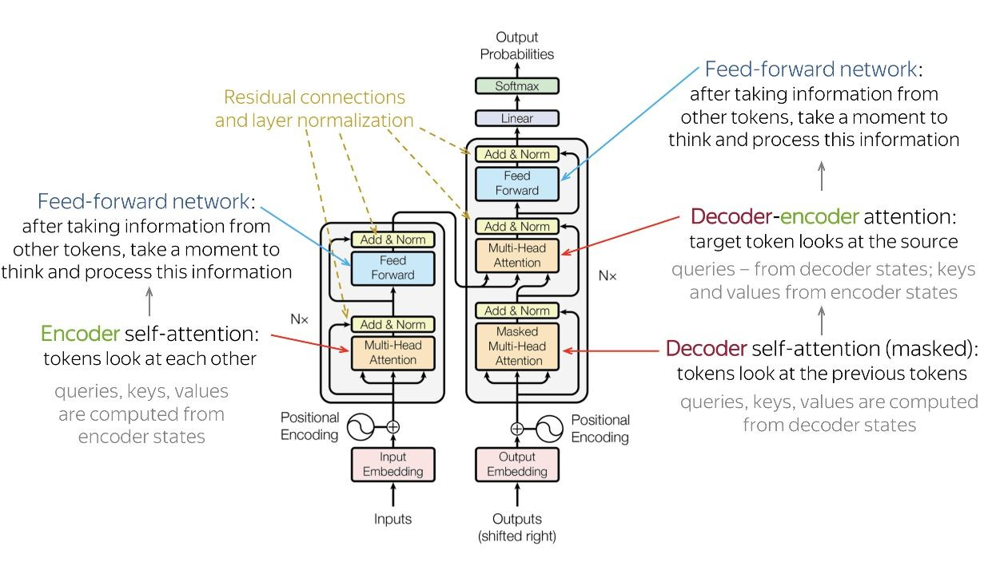
Full-Architecture

Slide 12
Training Details and Experimental Setup
Hardware Details:
Trained on 8 NVIDIA P100 GPU
The big models were trained for 300,000 steps (3.5 days)
Datasets:
Trained on WMT 2014 English-to-German translation task
4.5 million sentence pairs
Trained on WMT 2014 English-to-French translation task
36 million sentences
Sentences encoded using byte-pair encoding
Sentence pairs were batched together by approximate sequence length

Slide 13
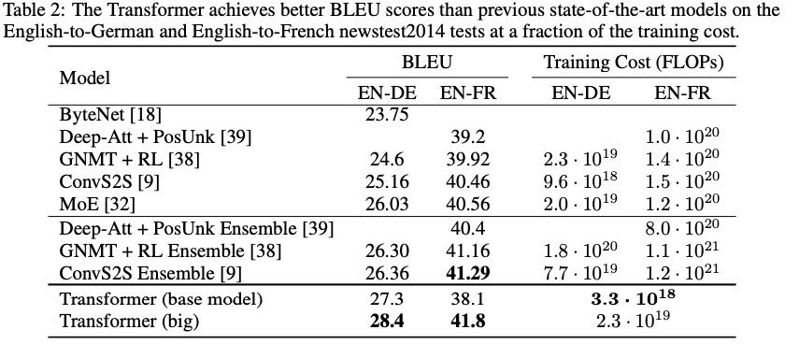
Experimental Results
New single-model state-of-the-art BLEU score of 41.8 for
English-to-French
Over 2 BLEU improvement
28.4 BLEU on the WMT 2014
English-to-German translation task
Over 100x less training loss
Generalizes well to other task

Slide 14
Discussion of Results
Extremely efficient for parallelization (great for GPU)
State-of-the-art performance
Authors understood significance of work:
In conclusion, authors state desire to “investigate local, restricted attention mechanisms to efficiently handle large inputs and outputs such as images, audio and video”
Unlike RNN, ability to directly learn dependencies

Slide 15
Critique / Limitations / Open Issues
Baseline transformers use O(n^2) in memory/computation.
increasing size of length increases computation quadratically
Fixed length unlike RNN of arbitrary length
Inability to process input sequentially (not like how the human brain works)
Paper addressing limitation of transformers: https://arxiv.org/pdf/2002.09402.pdf
Limited access to long memory
Limited ability to update state.

Slide 16
Future Work for Paper / Reading
Bigger and bigger transformers
NLP:
Masked Language Models
BERT - Bidirectional Transformers for NLP
RoBERTa
GPT-3
Computer Vision:
Vision Transformer (ViT)
Swin Transformers

Slide 17
Extended Readings
Good Sources for Explainability:
Relevant Papers:
Blogs:
Attention is All You Need: https://arxiv.org/abs/1706.03762
BERT: https://arxiv.org/abs/1810.04805
Roberta: https://arxiv.org/abs/1907.11692
Swin Transformer: Hierarchical Vision Transformer using Shifted Windows: https://arxiv.org/abs/2103.14030
https://jinglescode.github.io/2020/05/27/illustrated-gui de-transformer/
https://towardsdatascience.com/transformers-141e32 e69591
https://jalammar.github.io/illustrated-transformer/
https://medium.com/analytics-vidhya/neural-machine-t ranslation-using-bahdanau-attention-mechanism-d496 c9be30c3
Youtube:
https://www.youtube.com/watch?v=TQQlZhbC5ps

Slide 18
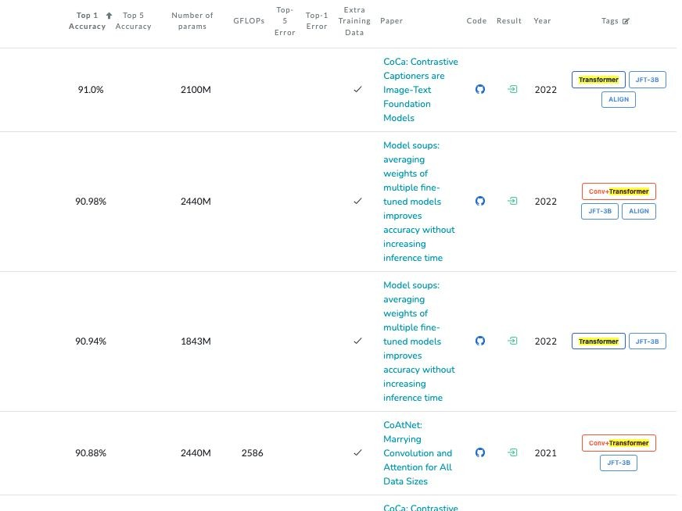
Summary
Transformers:
Image Classification on ImageNet
Dominate Everything
State of the art in Image Classification, Language Modeling, Speech Recognition, Vision Transformers (ex: ViT), Semantic Segmentation, Behavior / Decision Making, etc.
Transformers

